Slide 1



INSTITUTE: UIE (AIT-CSE)
CSS21: B.E. CSE (H) with specialization in Artificial Intelligence & Machine Learning
Advanced Machine Learning (20CSF-349)
Chapter 1.3: Advanced Regression
Lecture 15: Linear Discriminant Analysis (LDA)
By: Mr. Siddharth Kumar
DISCOVER . LEARN . EMPOWER

Slide 2
Advanced Machine Learning
Course Outcome
CO | Title
1 | Have a good understanding of the fundamental issues and challenges of machine learning: data, model selection, model complexity, etc.
2 | Appreciate the underlying mathematical relationships within and across Machine Learning algorithms and the paradigms of supervised and un-supervised learning
3 | Design and implement various machine learning algorithms in a range of real-world applications.
4 | Design and evaluate intelligent expert models for perception and prediction using machine learning algorithms
5 | Analyze and make use of machine learning algorithms-based applications using performance

Slide 3
Linear Discriminant Analysis
Linear Discriminant Analysis (LDA) is one of the commonly used dimensionality reduction techniques in machine learning to solve more than two-class classification problems. It is also known as Normal Discriminant Analysis (NDA) or Discriminant Function Analysis (DFA).
Although the logistic regression algorithm is limited to only two-class, linear Discriminant analysis is applicable for more than two classes of classification problems.
Linear Discriminant analysis is one of the most popular dimensionality reduction techniques used for supervised classification problems in machine learning. It is also considered a pre-processing step for modeling differences in ML and applications of pattern classification.
Whenever there is a requirement to separate two or more classes having multiple features efficiently, the Linear Discriminant Analysis model is considered the most common technique to solve such classification problems.

Slide 4
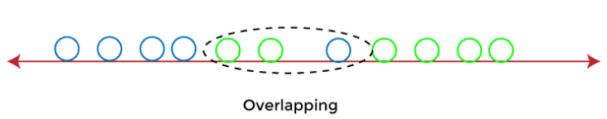
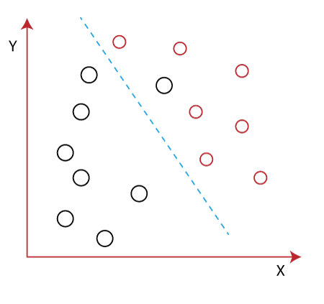
For e.g., if we have two classes with multiple features and need to separate them efficiently. When we classify them using a single feature, then it may show overlapping.
To overcome the overlapping issue in the classification process, we must increase the number of features regularly.
Example: Let's assume we have to classify two different classes having two sets of data points in a 2-dimensional plane as shown below image:

Slide 5
However, it is impossible to draw a straight line in a 2-d plane that can separate these data points efficiently but using linear Discriminant analysis; we can dimensionally reduce the 2-D plane into the 1-D plane. Using this technique, we can also maximize the separability between multiple classes.
How Linear Discriminant Analysis (LDA) works?
Linear Discriminant analysis is used as a dimensionality reduction technique in machine learning, using which we can easily transform a 2-D and 3-D graph into a 1-dimensional plane.
Let's consider an example where we have two classes in a 2-D plane having an X-Y axis, and we need to classify them efficiently. As we have already seen in the above example that LDA enables us to draw a straight line that can completely separate the two classes of the data points. Here, LDA uses an X-Y axis to create a new axis by separating them using a straight line and projecting data onto a new axis.
Hence, we can maximize the separation between these classes and reduce the 2-D plane into 1-D.

Slide 6
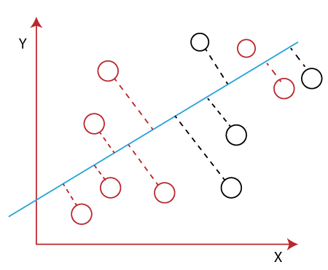
To create a new axis, Linear Discriminant Analysis uses the following criteria:
It maximizes the distance between means of two classes.
It minimizes the variance within the individual class.
Using the above two conditions, LDA generates a new axis in such a way that it can maximize the distance between the means of the two classes and minimizes the variation within each class.
In other words, we can say that the new axis will increase the separation between the data points of the two classes and plot them onto the new axis.

Slide 7
Why LDA?
Logistic Regression is one of the most popular classification algorithms that perform well for binary classification but falls short in the case of multiple classification problems with well-separated classes. At the same time, LDA handles these quite efficiently.
LDA can also be used in data pre-processing to reduce the number of features, just as PCA, which reduces the computing cost significantly.
LDA is also used in face detection algorithms. In Fisherfaces, LDA is used to extract useful data from different faces. Coupled with eigenfaces, it produces effective results.
Linear Discriminant analysis is one of the most simple and effective methods to solve classification problems in machine learning.
Some of the common real-world applications of Linear discriminant Analysis are Face Recognition, Medical, Customer Identification, Predictions etc.

Slide 8
References
T1: Mitchell T.M., Machine Learning, McGraw Hill (1997).
T2: Andreas C. Miller, Sarah Guido, Introduction to Machine Learning with Python, O’REILLY (2001).
Notes:
Introduction to Cyber Security (simplilearn.com)

Slide 9

THANK YOU

